Slide 1
Functional Testing
Anika Tabassum
Lecturer
CSE, EWU

Slide 2
Functional Testing
Is a type of software testing that validates the software system against the functional requirements/specifications.
The purpose of Functional tests is to test each function of the software application, by providing appropriate input, verifying the output against the Functional requirements.
Mainly involves black box testing and it is not concerned about the source code of the application.
Checks User Interface, APIs, Database, Security, Client/Server communication and other functionality of the Application Under Test.
Can be done either manually or using automation.

Slide 3
What do you test in Functional Testing?
Mainline functions: Testing the main functions of an application
Basic Usability: It involves basic usability testing of the system. It checks whether a user can freely navigate through the screens without any difficulties.
Accessibility: Checks the accessibility of the system for the user
Error Conditions: Usage of testing techniques to check for error conditions. It checks whether suitable error messages are displayed.

Slide 4
How to do Functional Testing
Understand the Functional Requirements
Identify test input or test data based on requirements
Compute the expected outcomes with selected test input values
Execute test cases
Compare actual and computed expected results

Slide 5
Functional Testing Types
Unit testing
Smoke testing
User Acceptance
Integration Testing
Regression testing
Localization
Globalization
Interoperability

Slide 6
Let’s see in details!
Unit testing is the process where you test the smallest functional unit of code.
Smoke testing, also called build verification testing or confidence testing, is a software testing method that is used to determine if a new software build is ready for the next testing phase. This testing method determines if the most crucial functions of a program work but does not delve into finer details. As a preliminary check of software, smoke testing finds basic and critical issues in an application before more in-depth testing is done.

Slide 7
Let’s see in details!
User acceptance testing (UAT), also called application testing or end-user testing, is a phase of software development in which the software is tested in the real world by its intended audience.
Integration testing (sometimes called integration and testing, abbreviated I&T) is the phase in software testing in which the whole software module is tested or if it consists of multiple software modules they are combined and then tested as a group.

Slide 8
Let’s see in details!
Regression Testing is a type of testing in the software development cycle that runs after every change to ensure that the change introduces no unintended breaks. Regression testing addresses a common issue that developers face — the emergence of old bugs with the introduction of new changes.
Localization testing involves verifying that the application works correctly in the local environment, such as the correct translation of the text, the use of appropriate symbols and characters, and compliance with local regulations and standards.

Slide 9
Let’s see in details!
Globalization Testing is a type of software testing that is performed to ensure the system or software application can function independently of the geographical and cultural environment. It ensures that the application can be used all over the world and accepts all language texts.
Interoperability testing is a type of software testing that verifies the compatibility and communication of different systems, applications, or devices. It ensures that the data exchange and functionality are consistent and reliable across various platforms and environments.

Slide 10
Functional Vs Non-Functional Testing
Functional testing is performed using the functional specification provided by the client and verifies the system against the functional requirements.
Functional testing is executed first
Manual Testing or automation tools can be used for functional testing
Business requirements are the inputs to functional testing
Functional testing describes what the product does
Non-Functional testing checks the Performance, reliability, scalability and other non-functional aspects of the software system.
Non-functional testing should be performed after functional testing
Using tools will be effective for this testing
Performance parameters like speed, scalability are inputs to non-functional testing.
Nonfunctional testing describes how good the product works

Slide 11
Functional Vs Non-Functional Testing
Easy to do Manual Testing
Examples of Functional testing are
Unit Testing
Smoke Testing
Sanity Testing
Integration Testing
White box testing
Black Box testing
User Acceptance testing
Regression Testing
Tough to do Manual Testing
Examples of Non-functional testing are
Performance Testing
Load Testing
Volume Testing
Stress Testing
Security Testing
Installation Testing
Penetration Testing
Compatibility Testing
Migration Testing

Slide 12
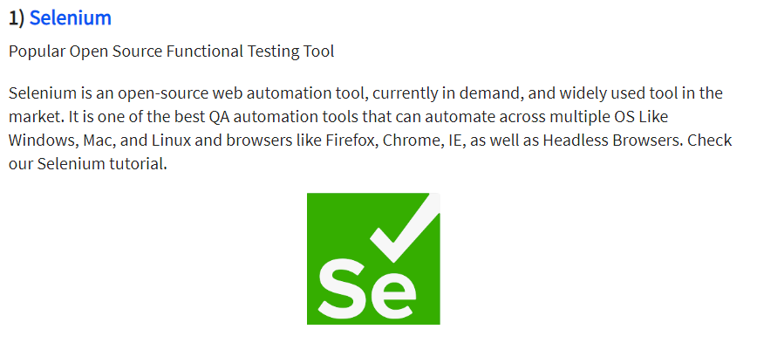
Functional Testing Tools

Slide 13
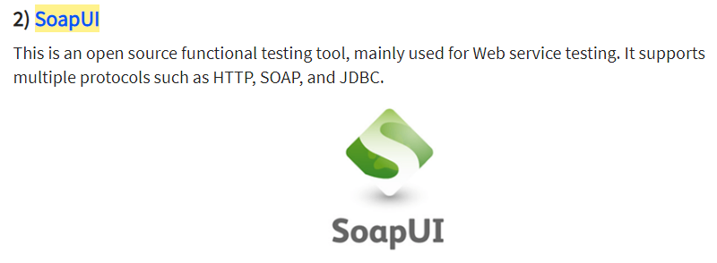
Functional Testing Tools

Slide 14
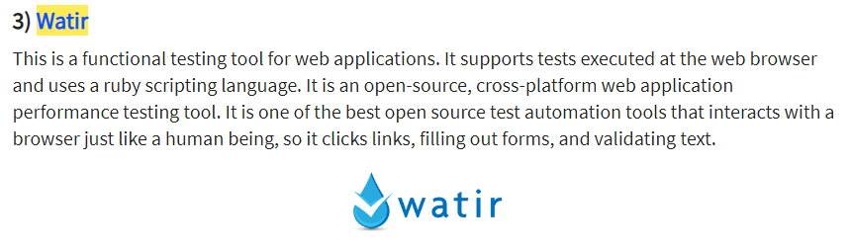
Functional Testing Tools

Slide 15
Functional Testing Tools
4) QTP – Very user-friendly Functional Test tool by HP
5) JUnit– Used mainly for Java applications and this can be used in Unit and System Testing

